Slide 1
Initial conditions in PMd covary with RT, are altered by trial outcome, and combine with sensory evidence to induce choice-related dynamics
Pierre Boucher, Tian Wang, Laura Carceroni, Gary Kane, Krishna V. Shenoy & Chandramouli Chandrasekaran

Slide 2
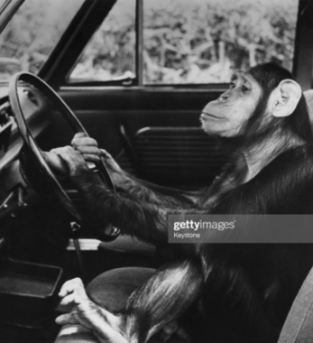
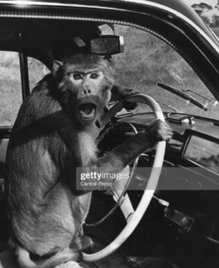
Chill chimp
Mad macaque

Slide 3
Introduction - Take aways
Dynamical systems perspective
Initial conditions predict neural dynamics and behavior
Choice-selective dynamics depend on initial conditions and the stimulus
What changes initial conditions trial-to-trial?

Slide 4
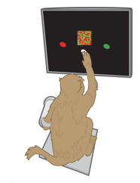
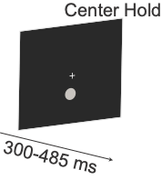
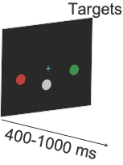
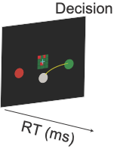
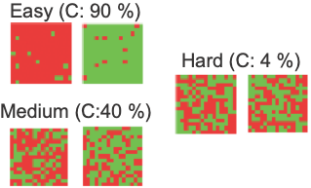
Red-green checkerboard discrimination task

Slide 5
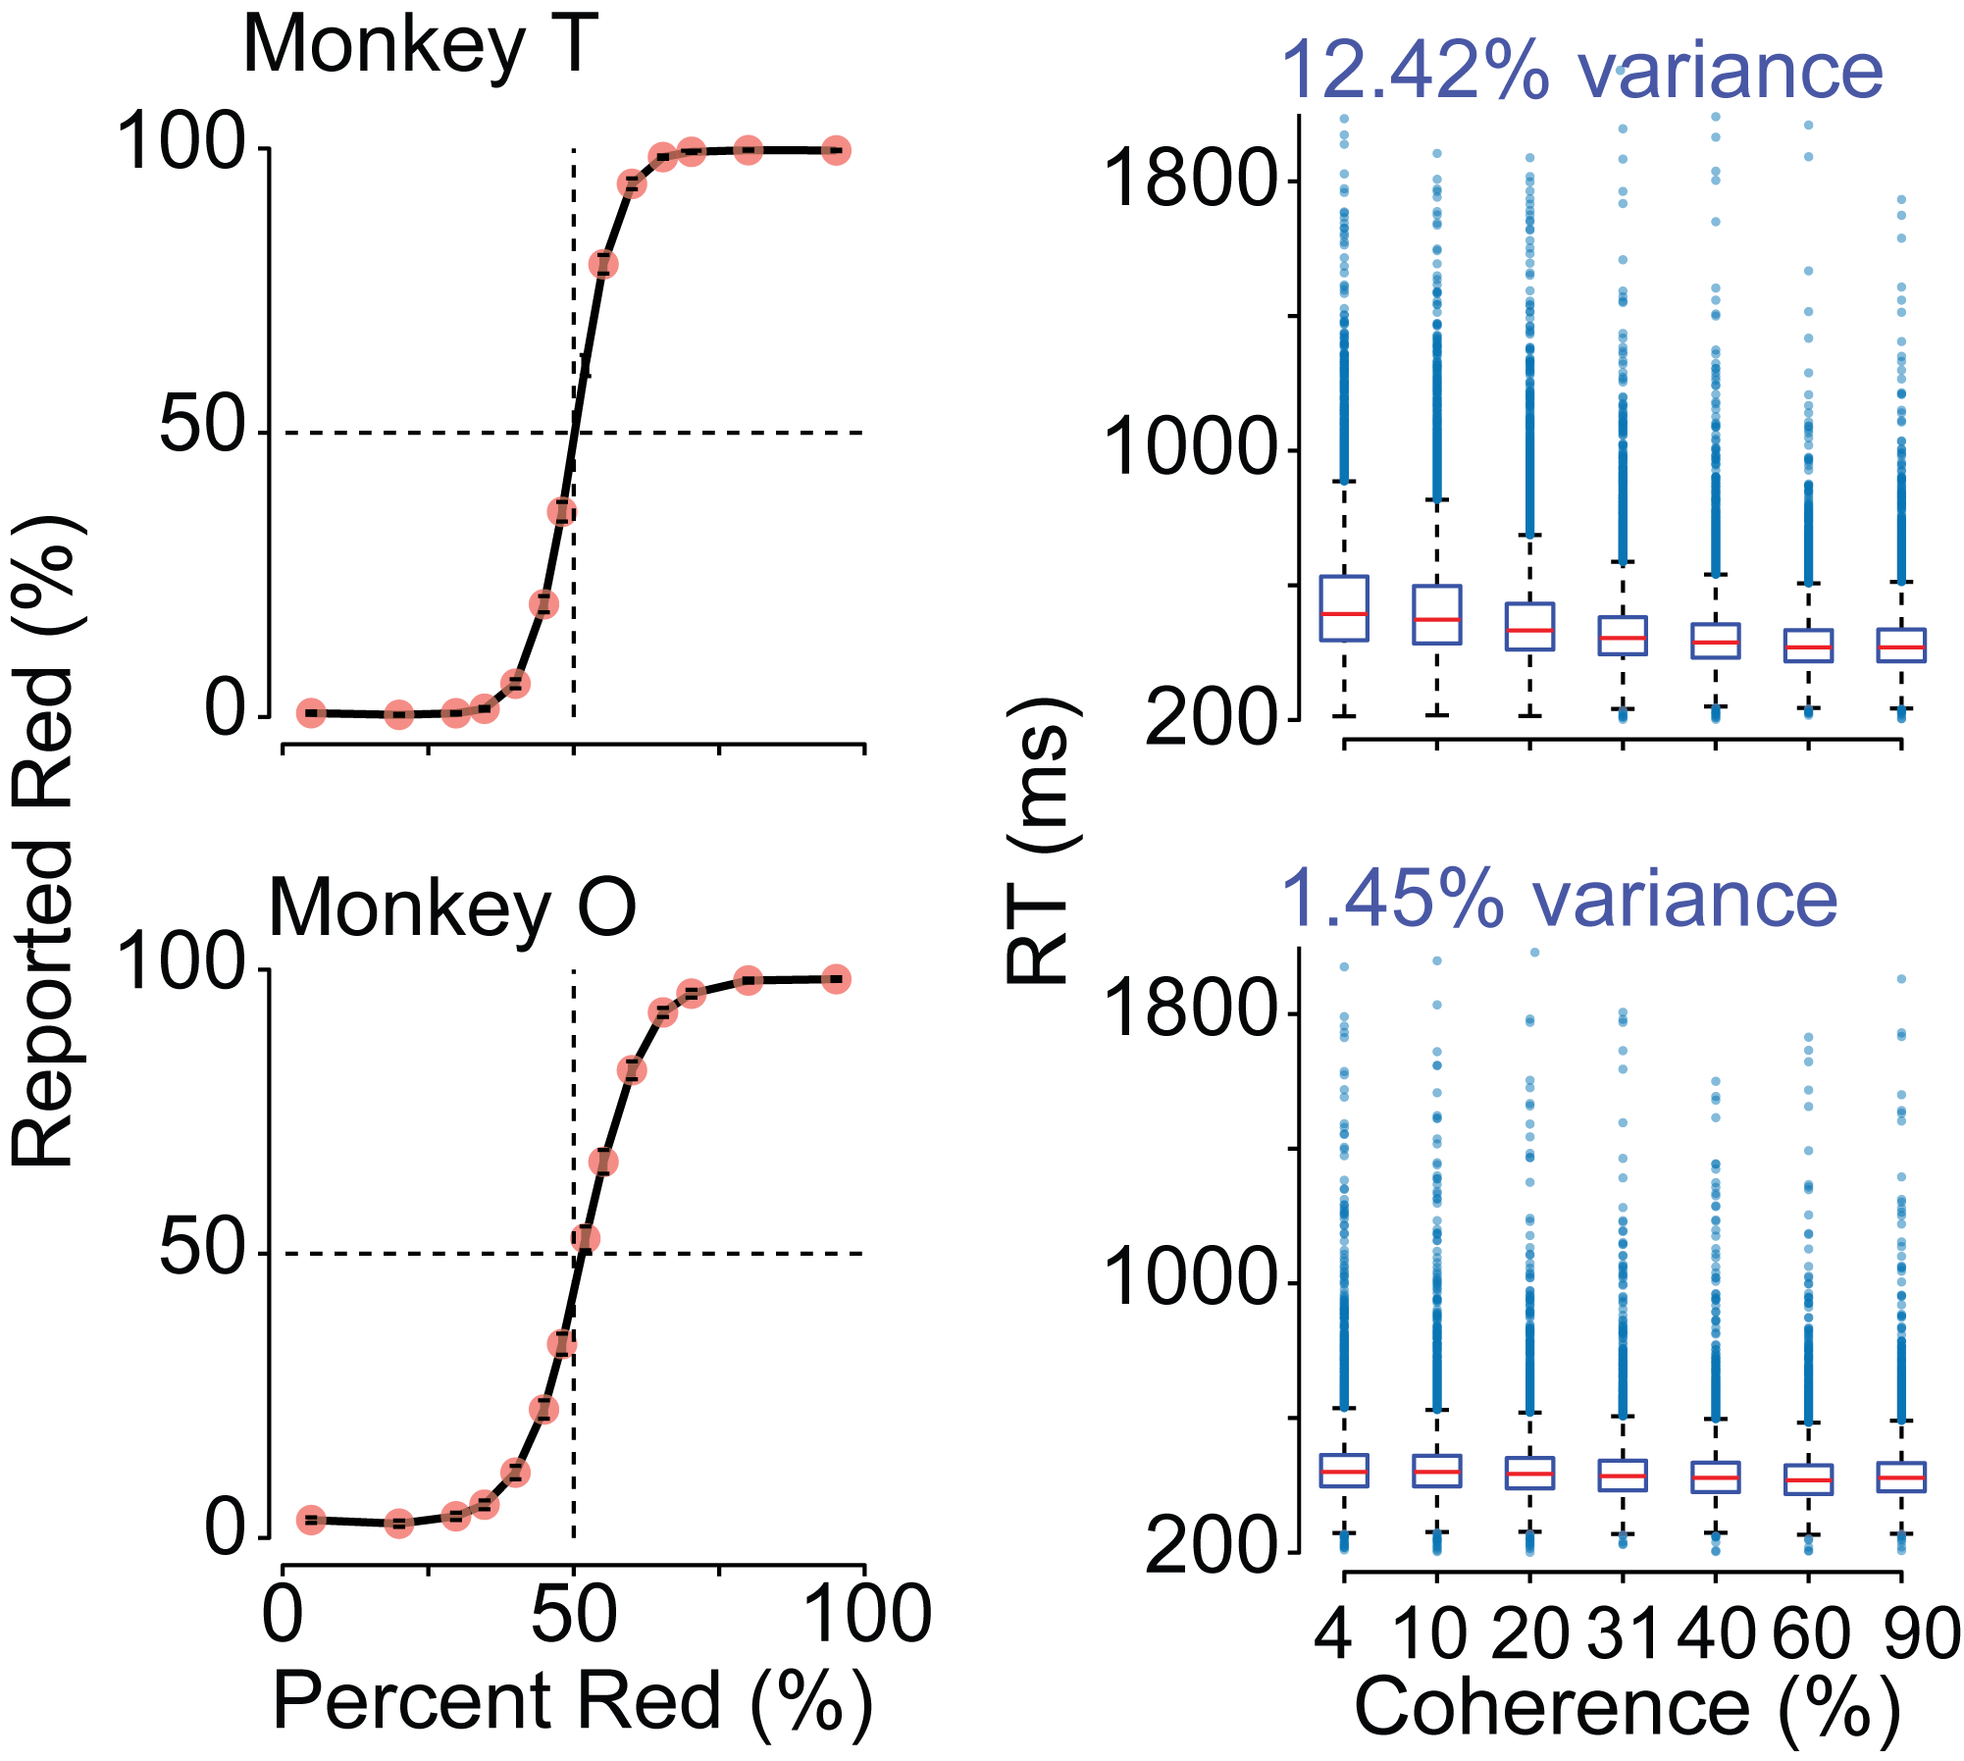
Decision-making is dependent on sensory evidence and internal state

Slide 6
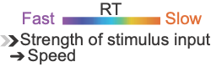
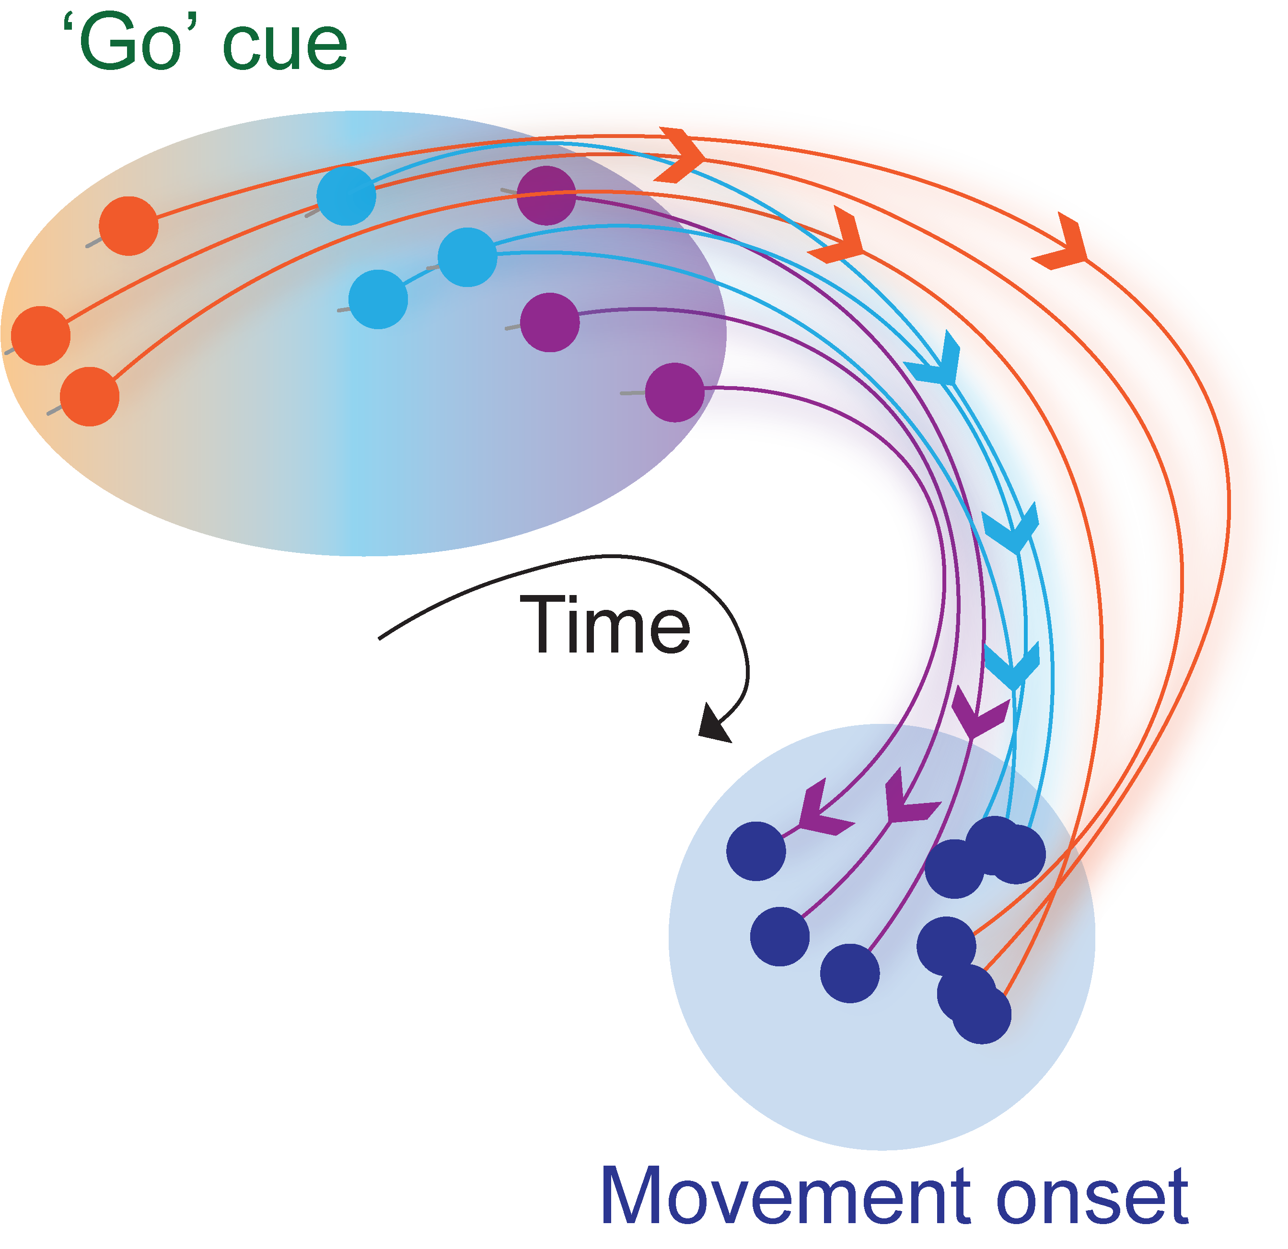
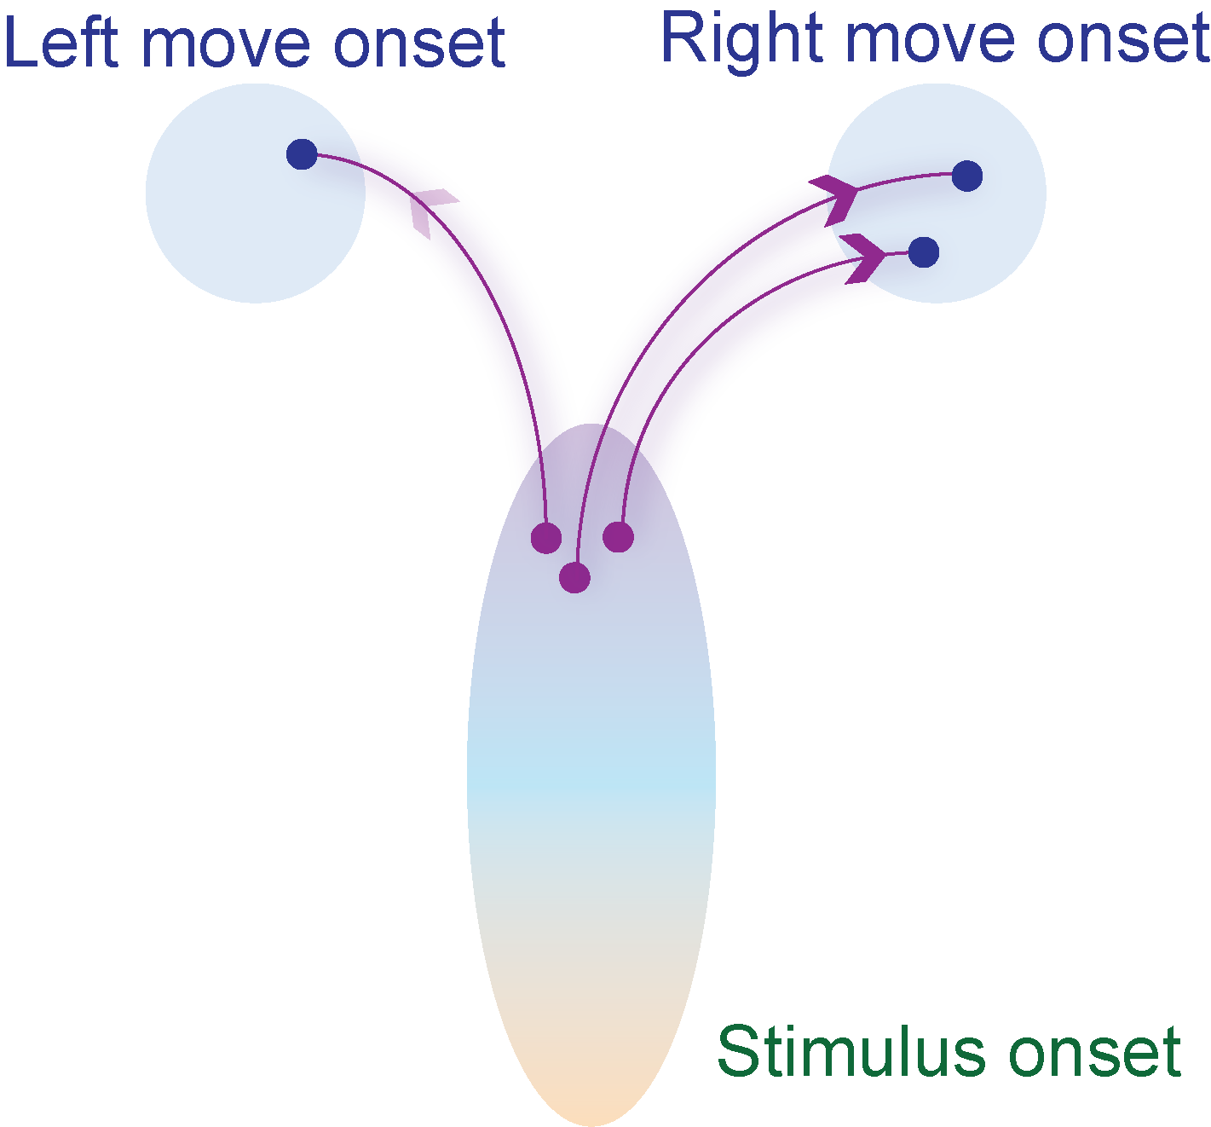
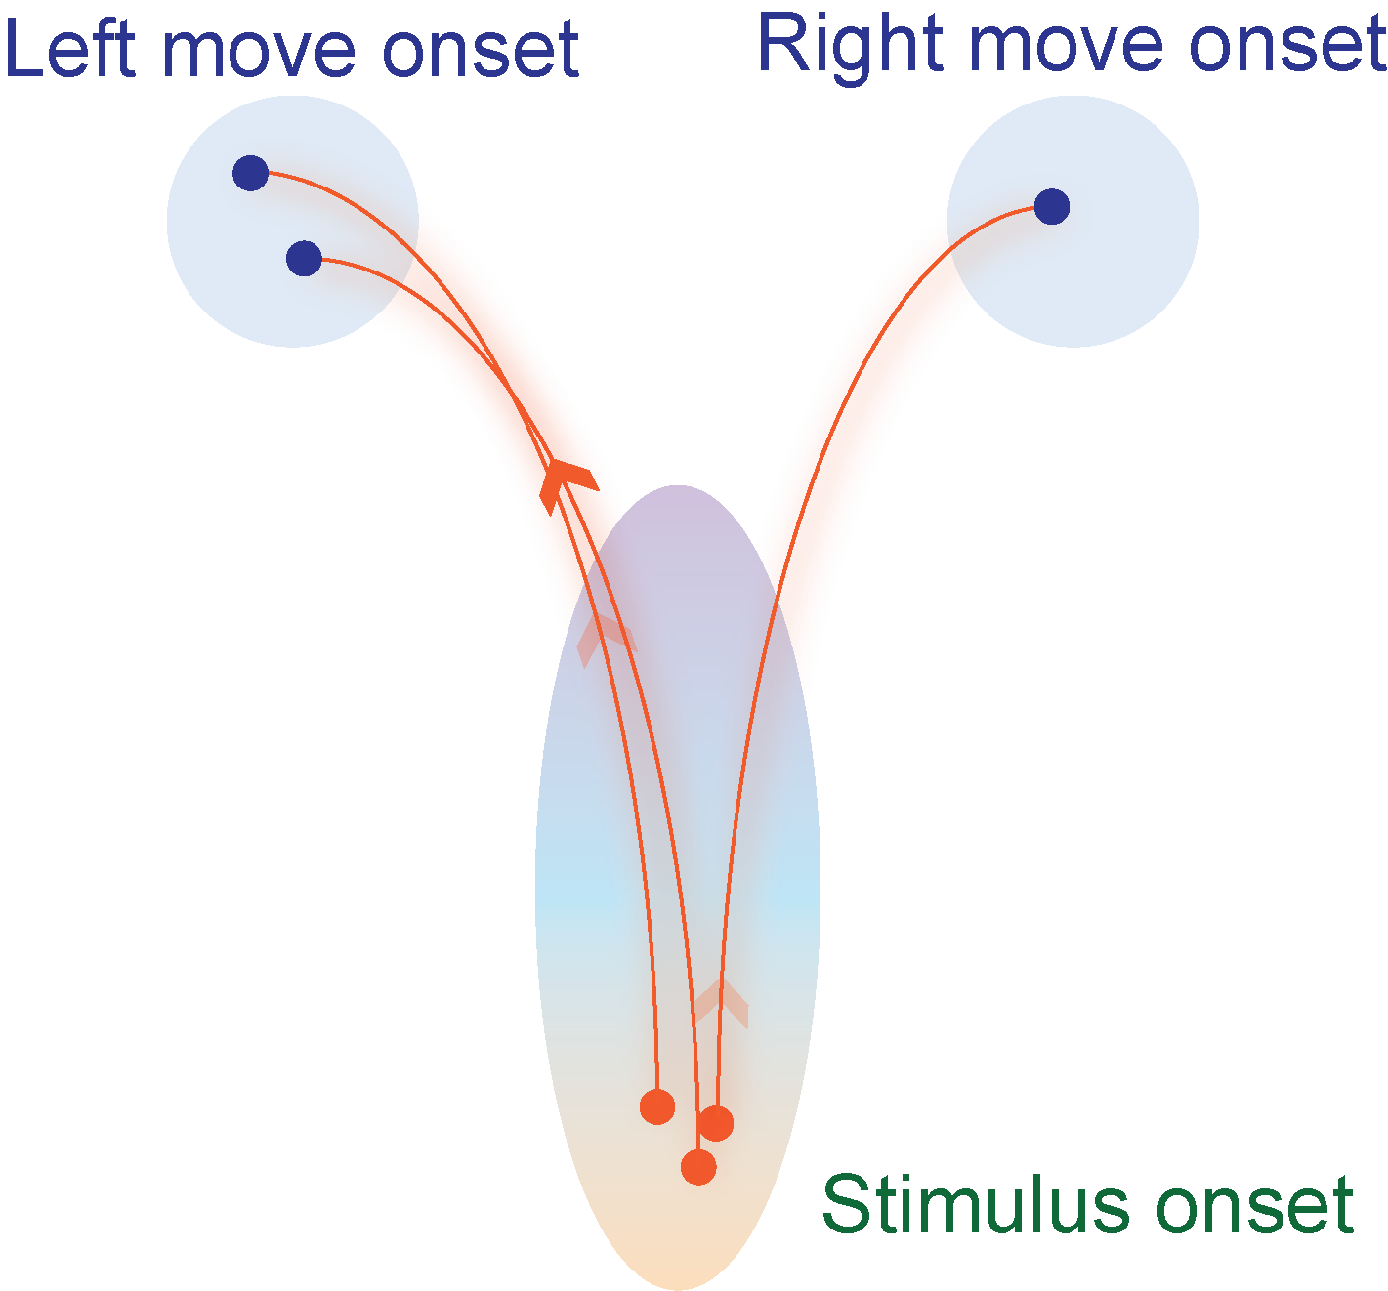
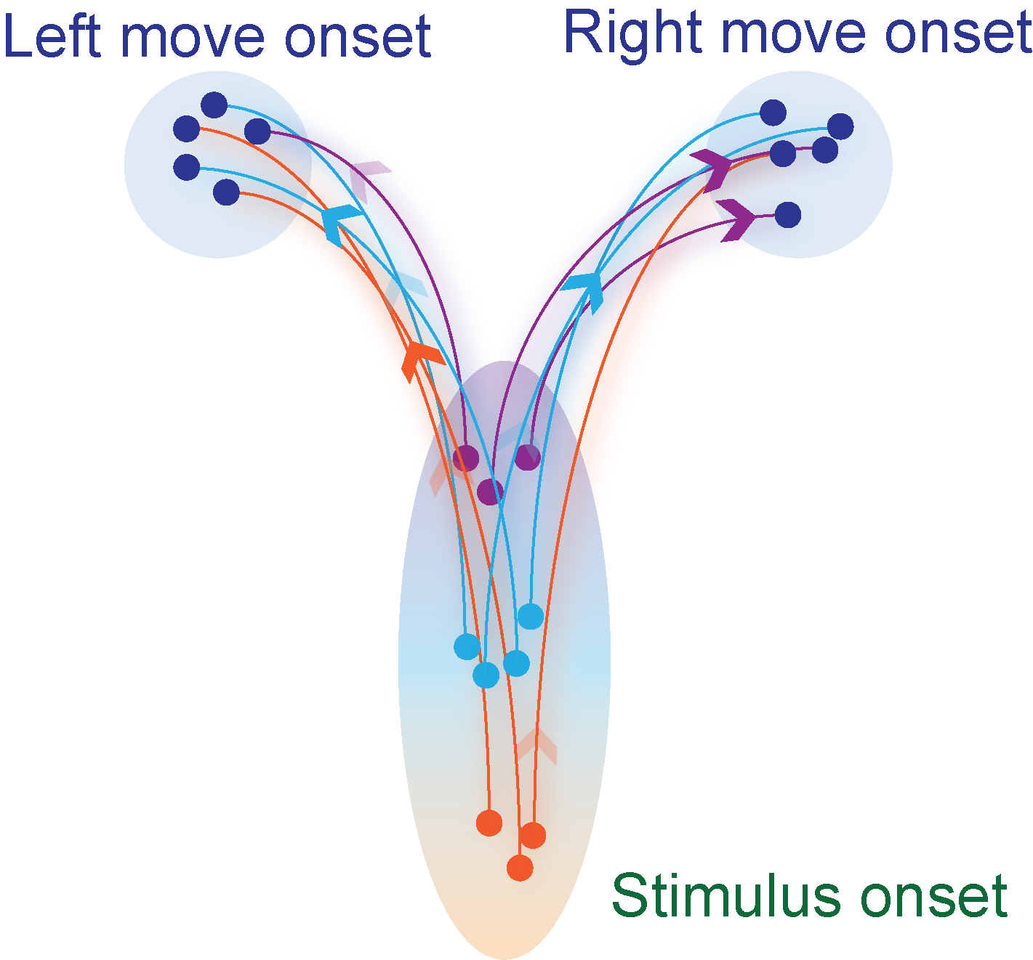
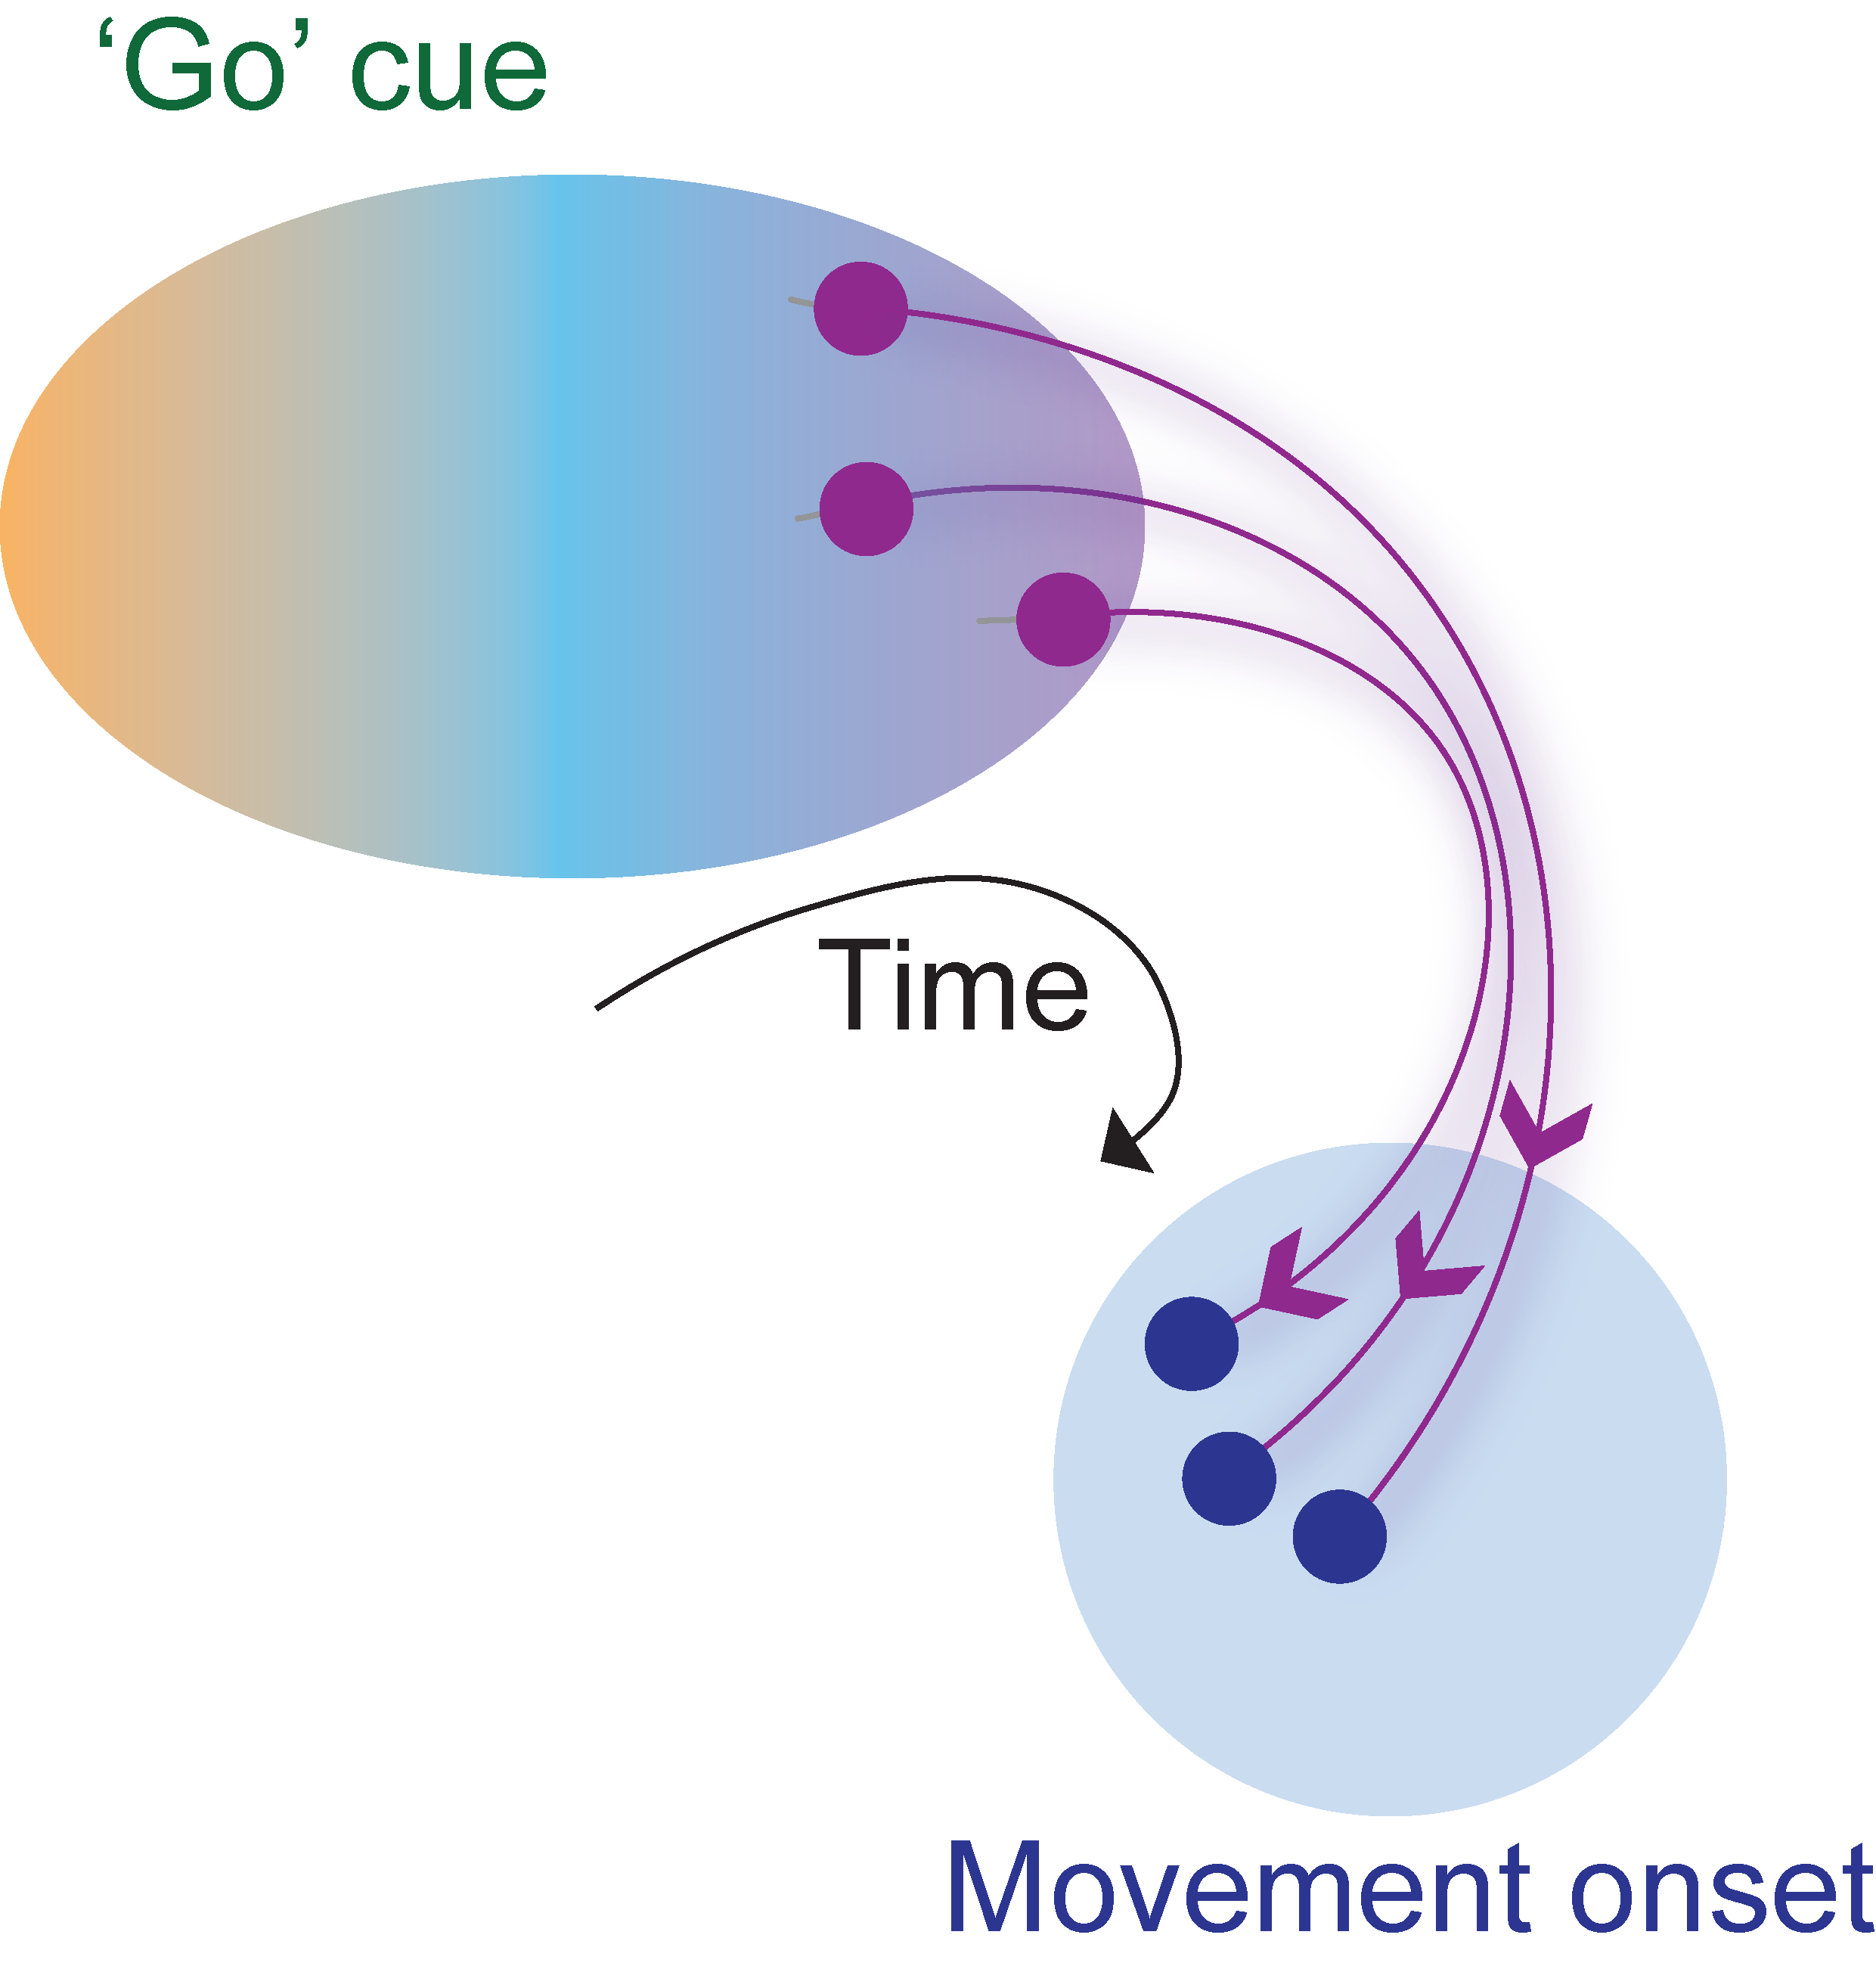
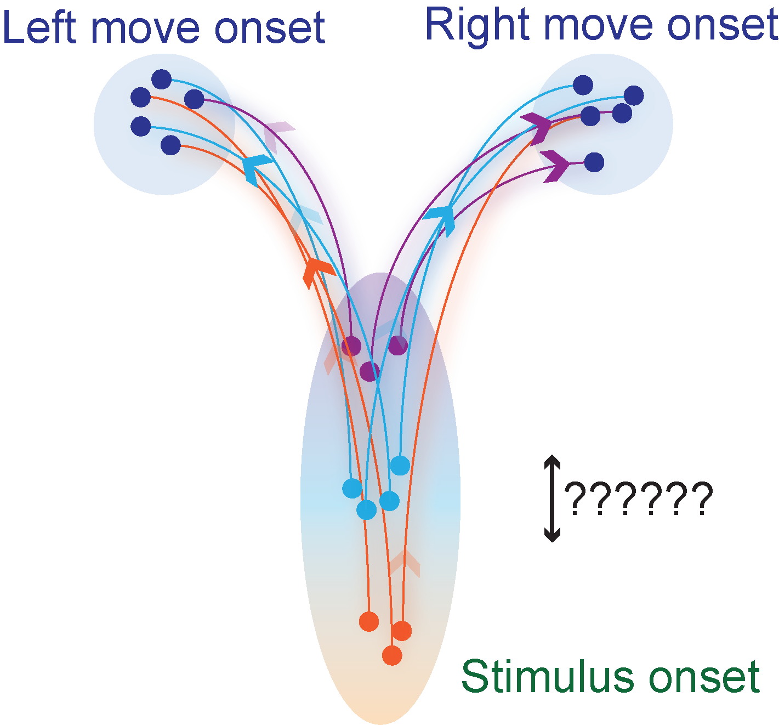
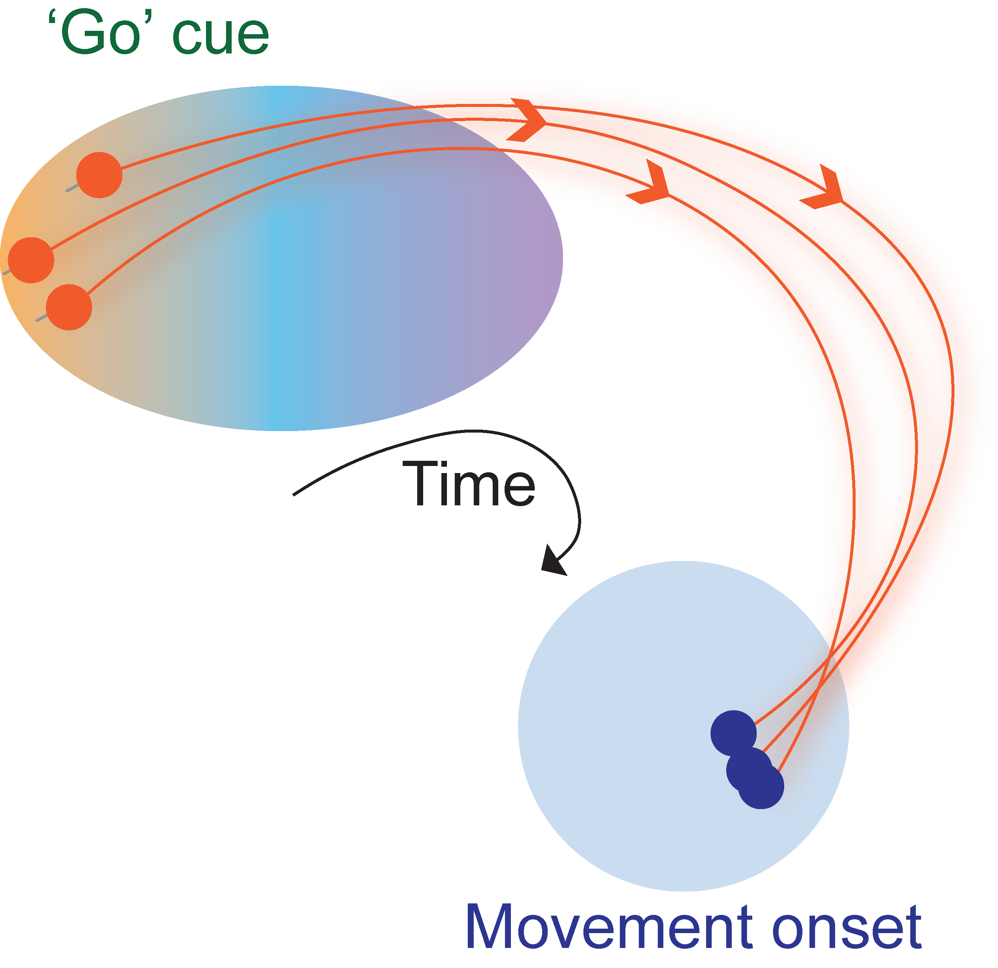
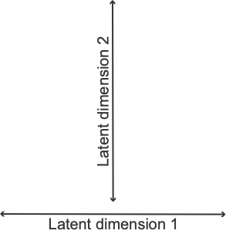
Hypotheses

Slide 7
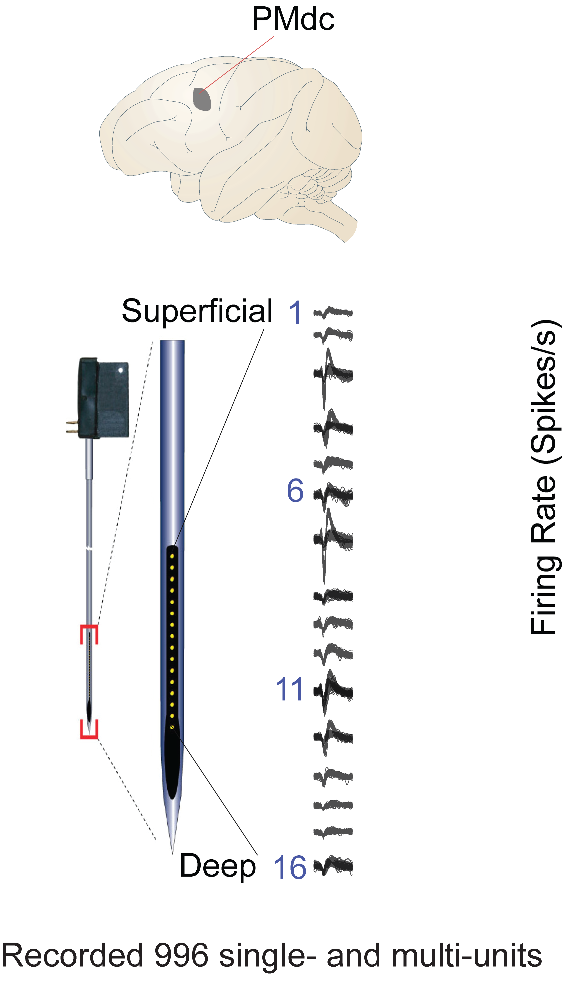
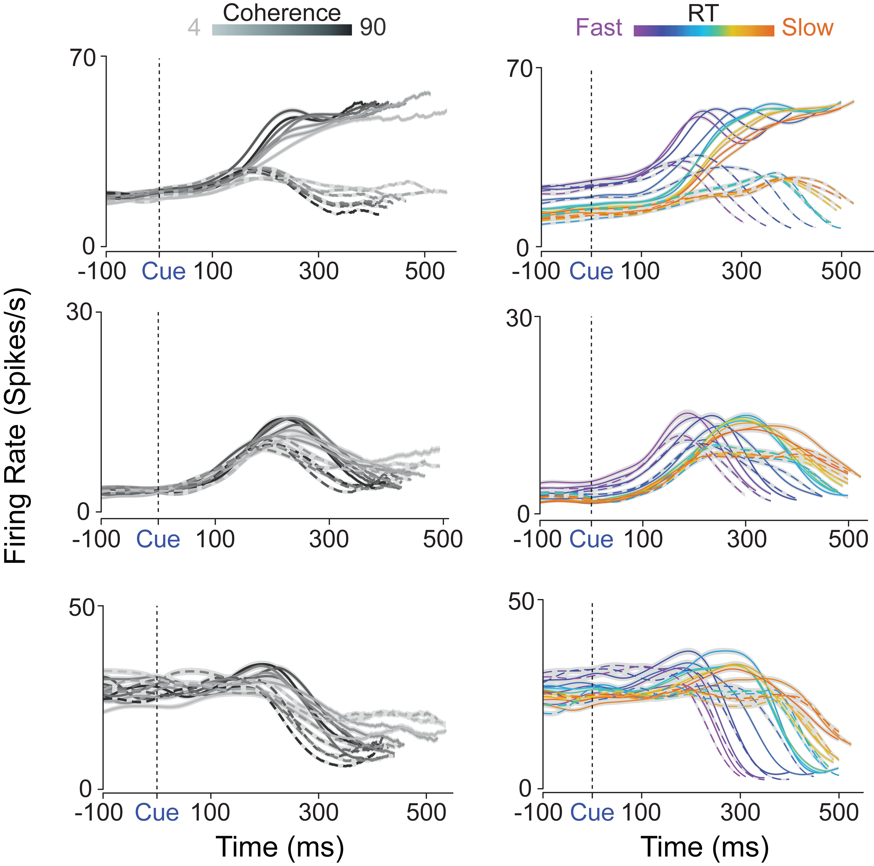
Single-unit prestimulus firing rates covary with RT and post stimulus activity is input dependent

Slide 8

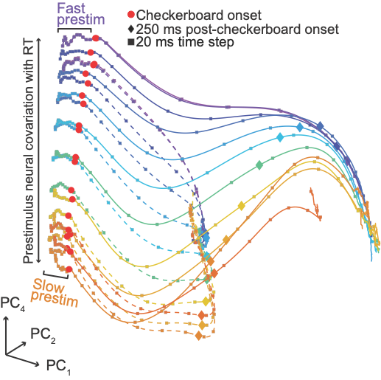
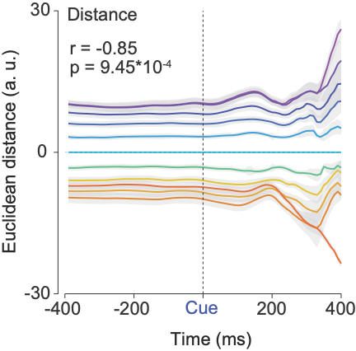
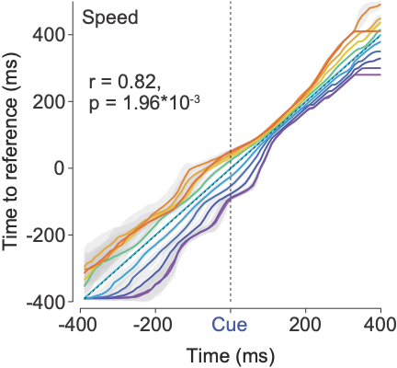
Position and “velocity” of initial condition correlate with post stimulus dynamics and RT

Slide 9
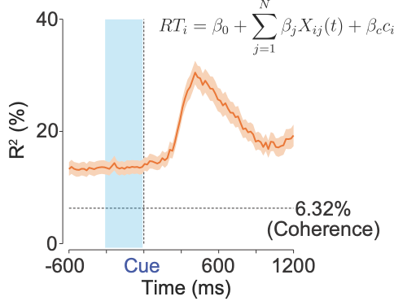
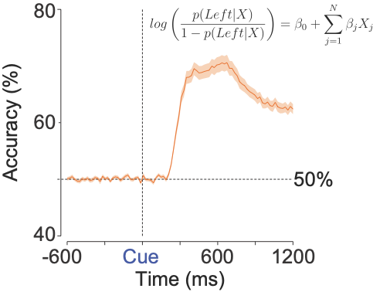
Initial conditions predict RT but do not predict eventual choice

Slide 10
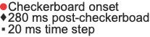
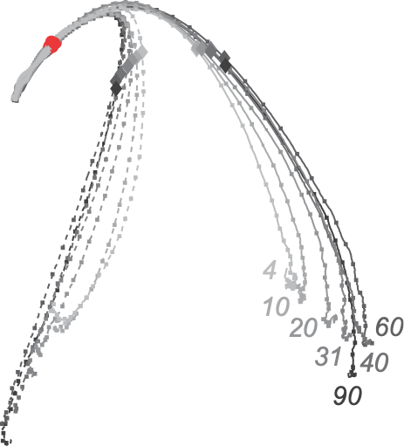
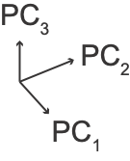
Poststimulus dynamics vary with stimulus difficulty

Slide 11

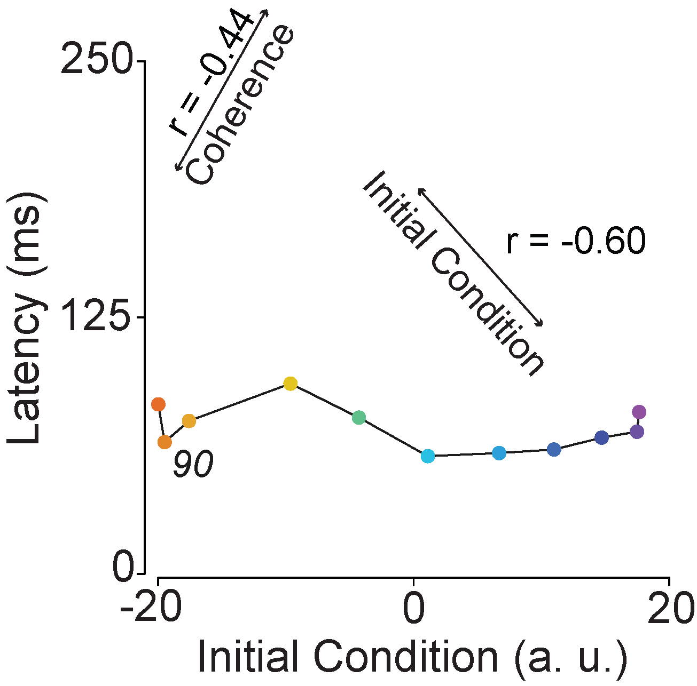
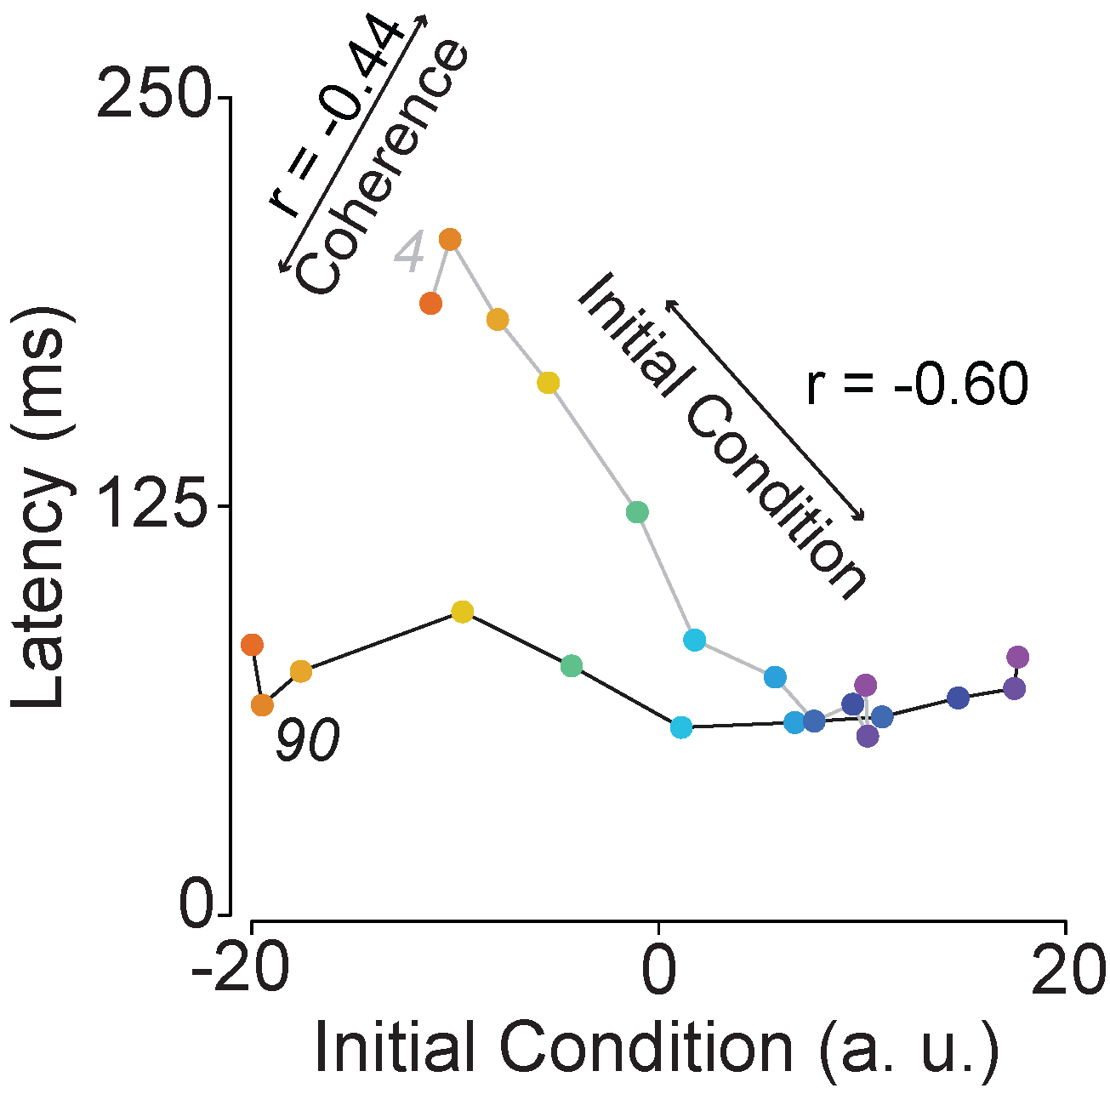
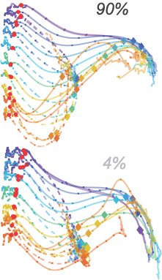
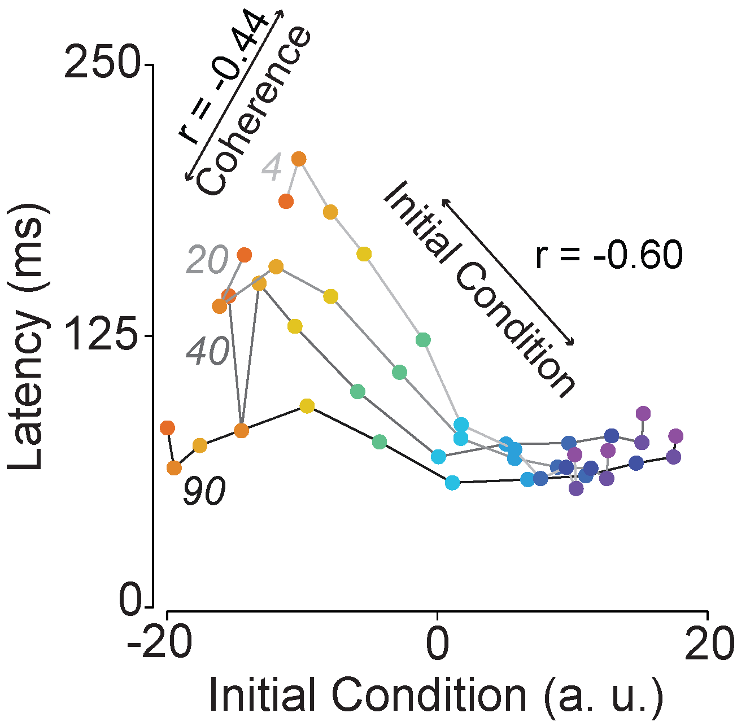
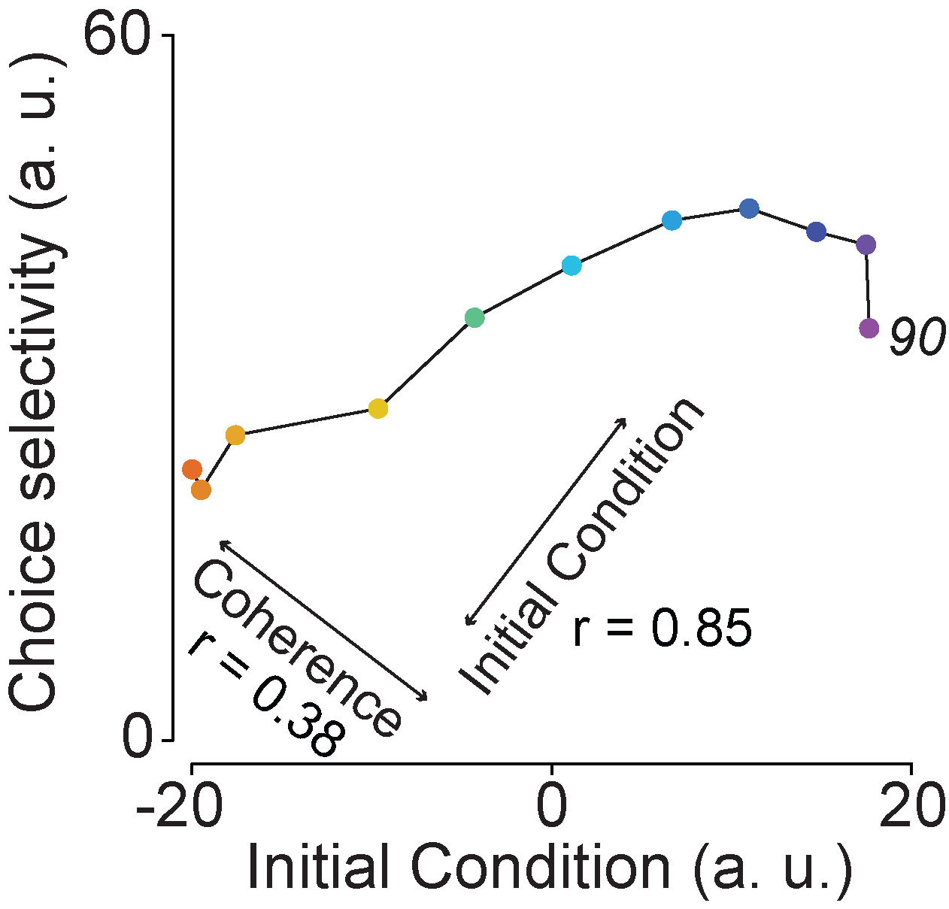
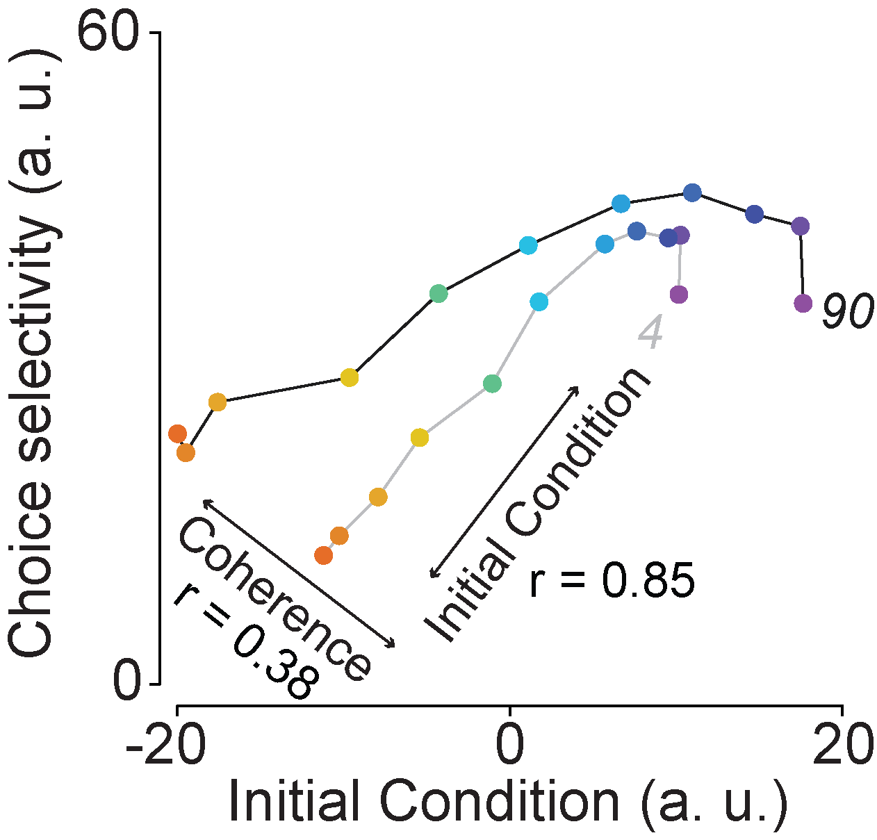
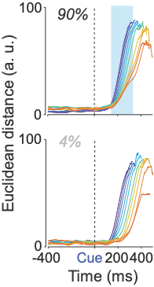
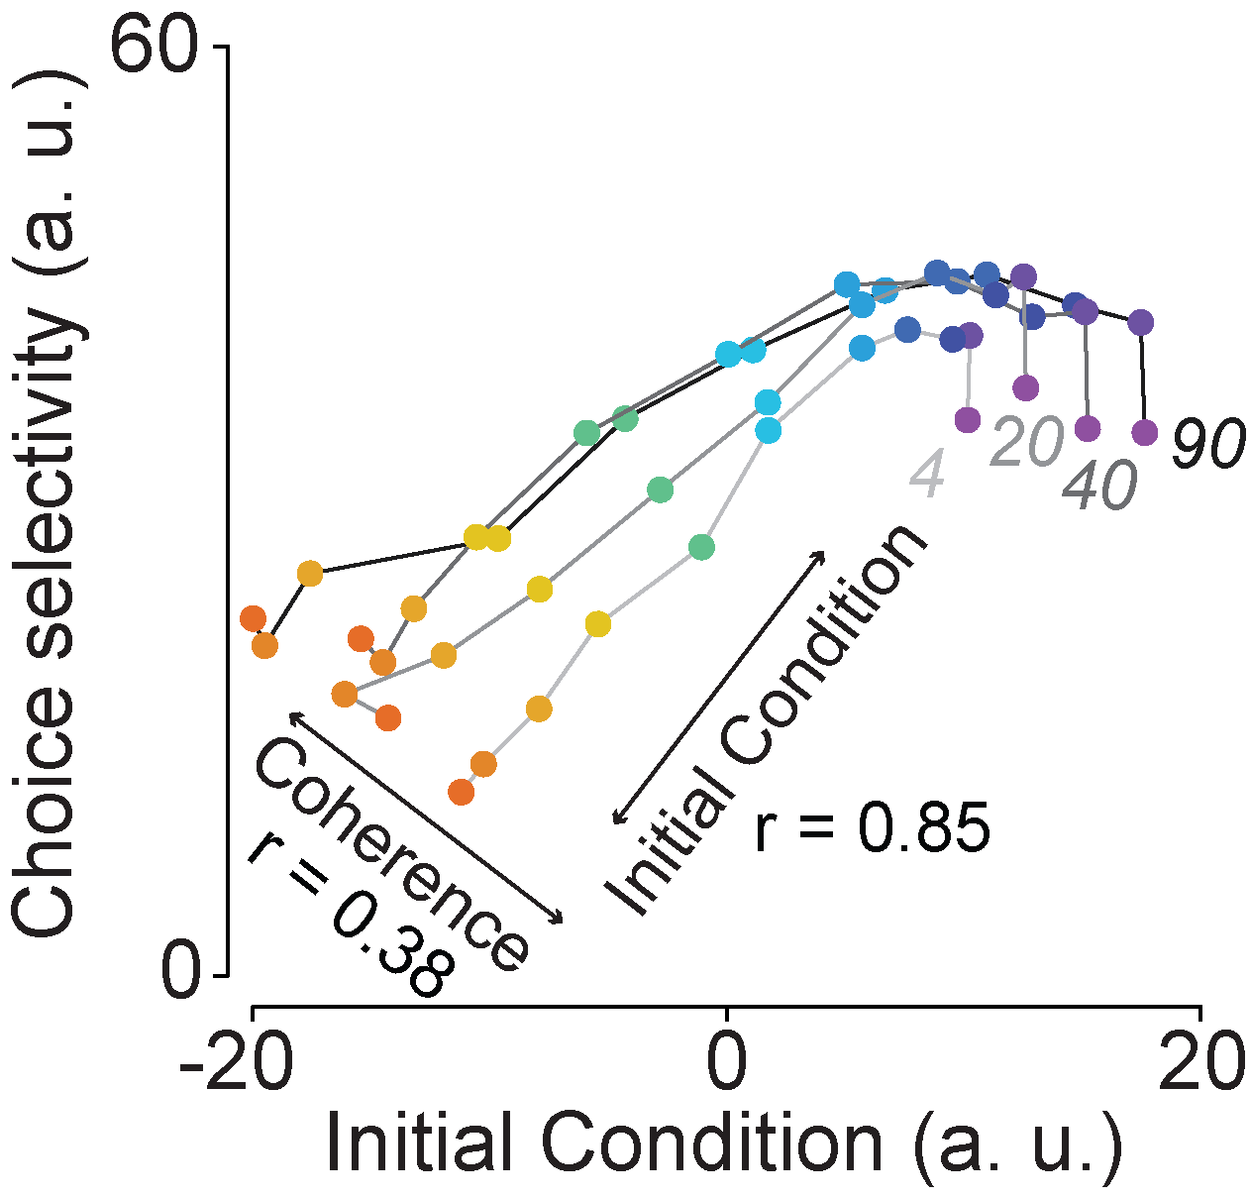
Inputs and initial conditions both contribute to the speed of poststimulus decision-related dynamics

Slide 12
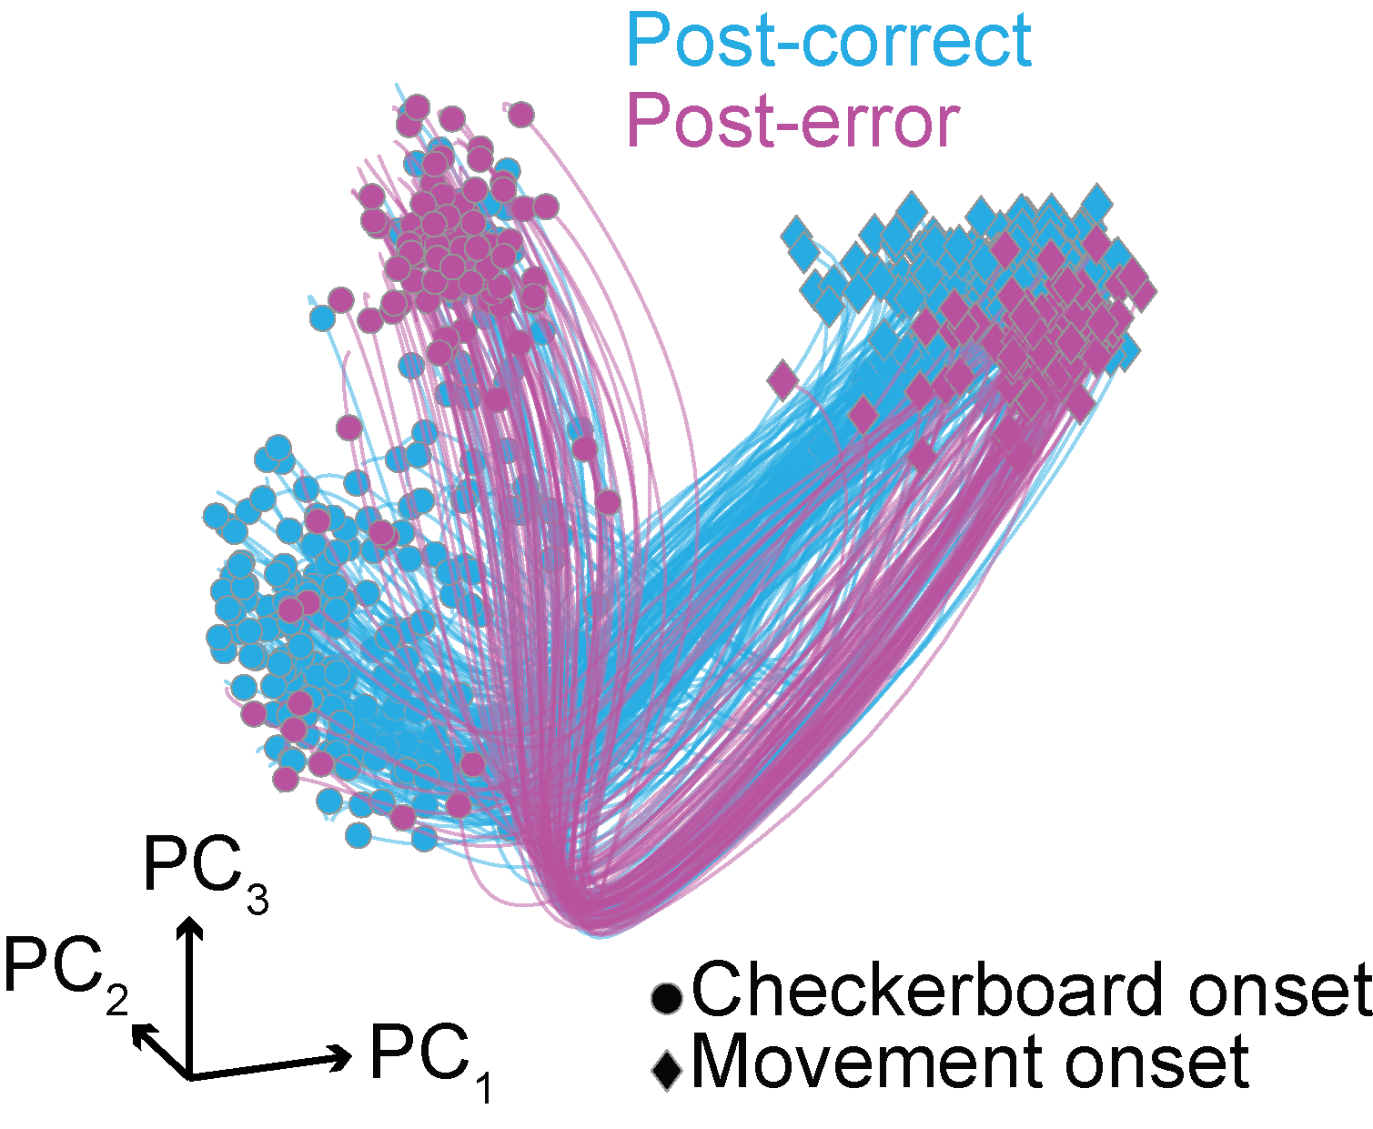
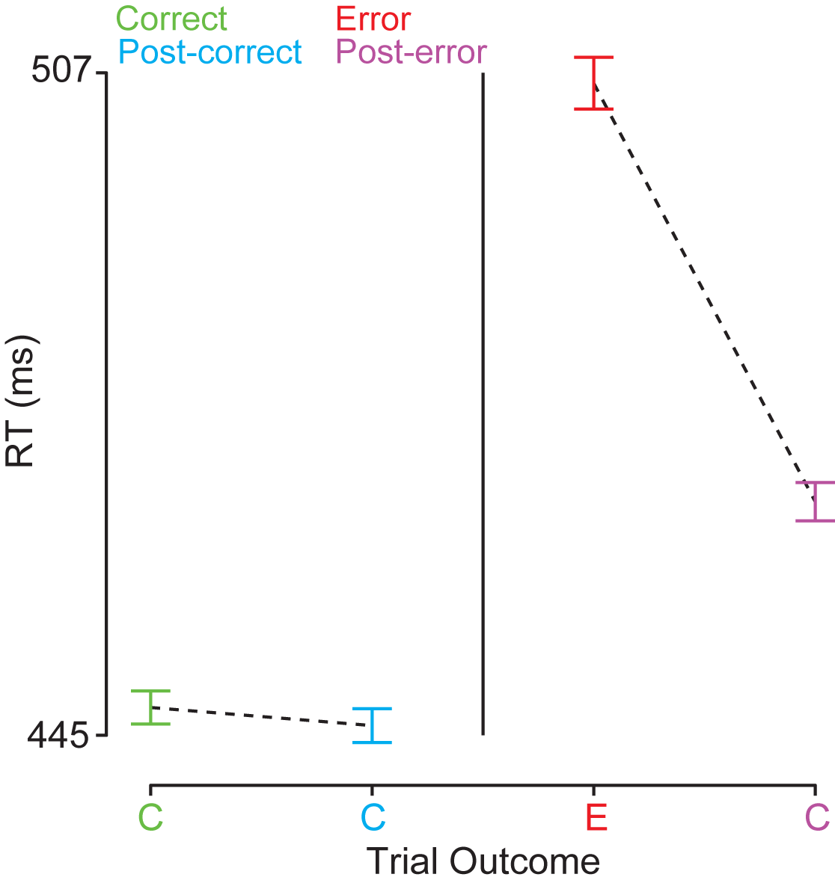
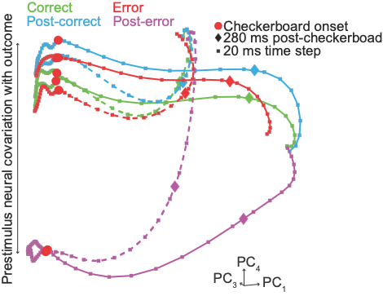
The outcome of the previous trial influences the initial condition

Slide 13
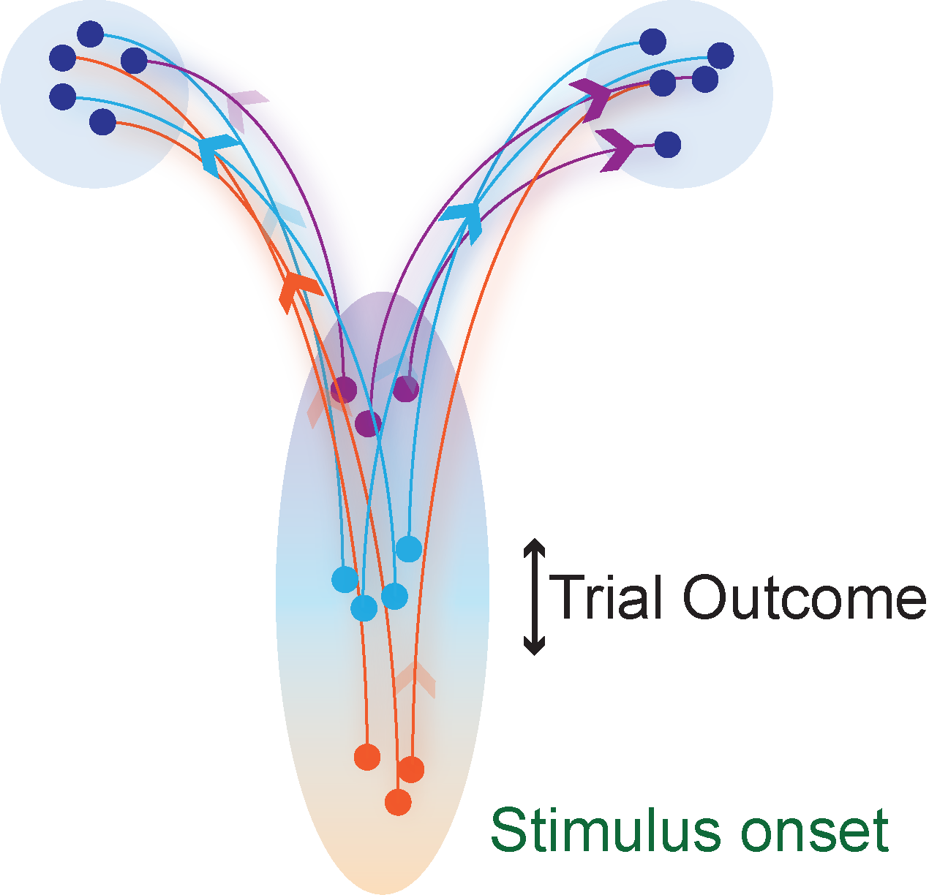
Conclusions
Lawful, low-dimensional neural activity
Initial conditions strongly impact decision-related dynamics and behavior
Initial conditions combine with sensory evidence
Initial condition varies with trial outcome
Bridges previously disparate findings from SAT, PES and motor planning

Slide 14




Thank you
Tian Wang
Dr. Chandramouli Chandrasekaran

Slide 15
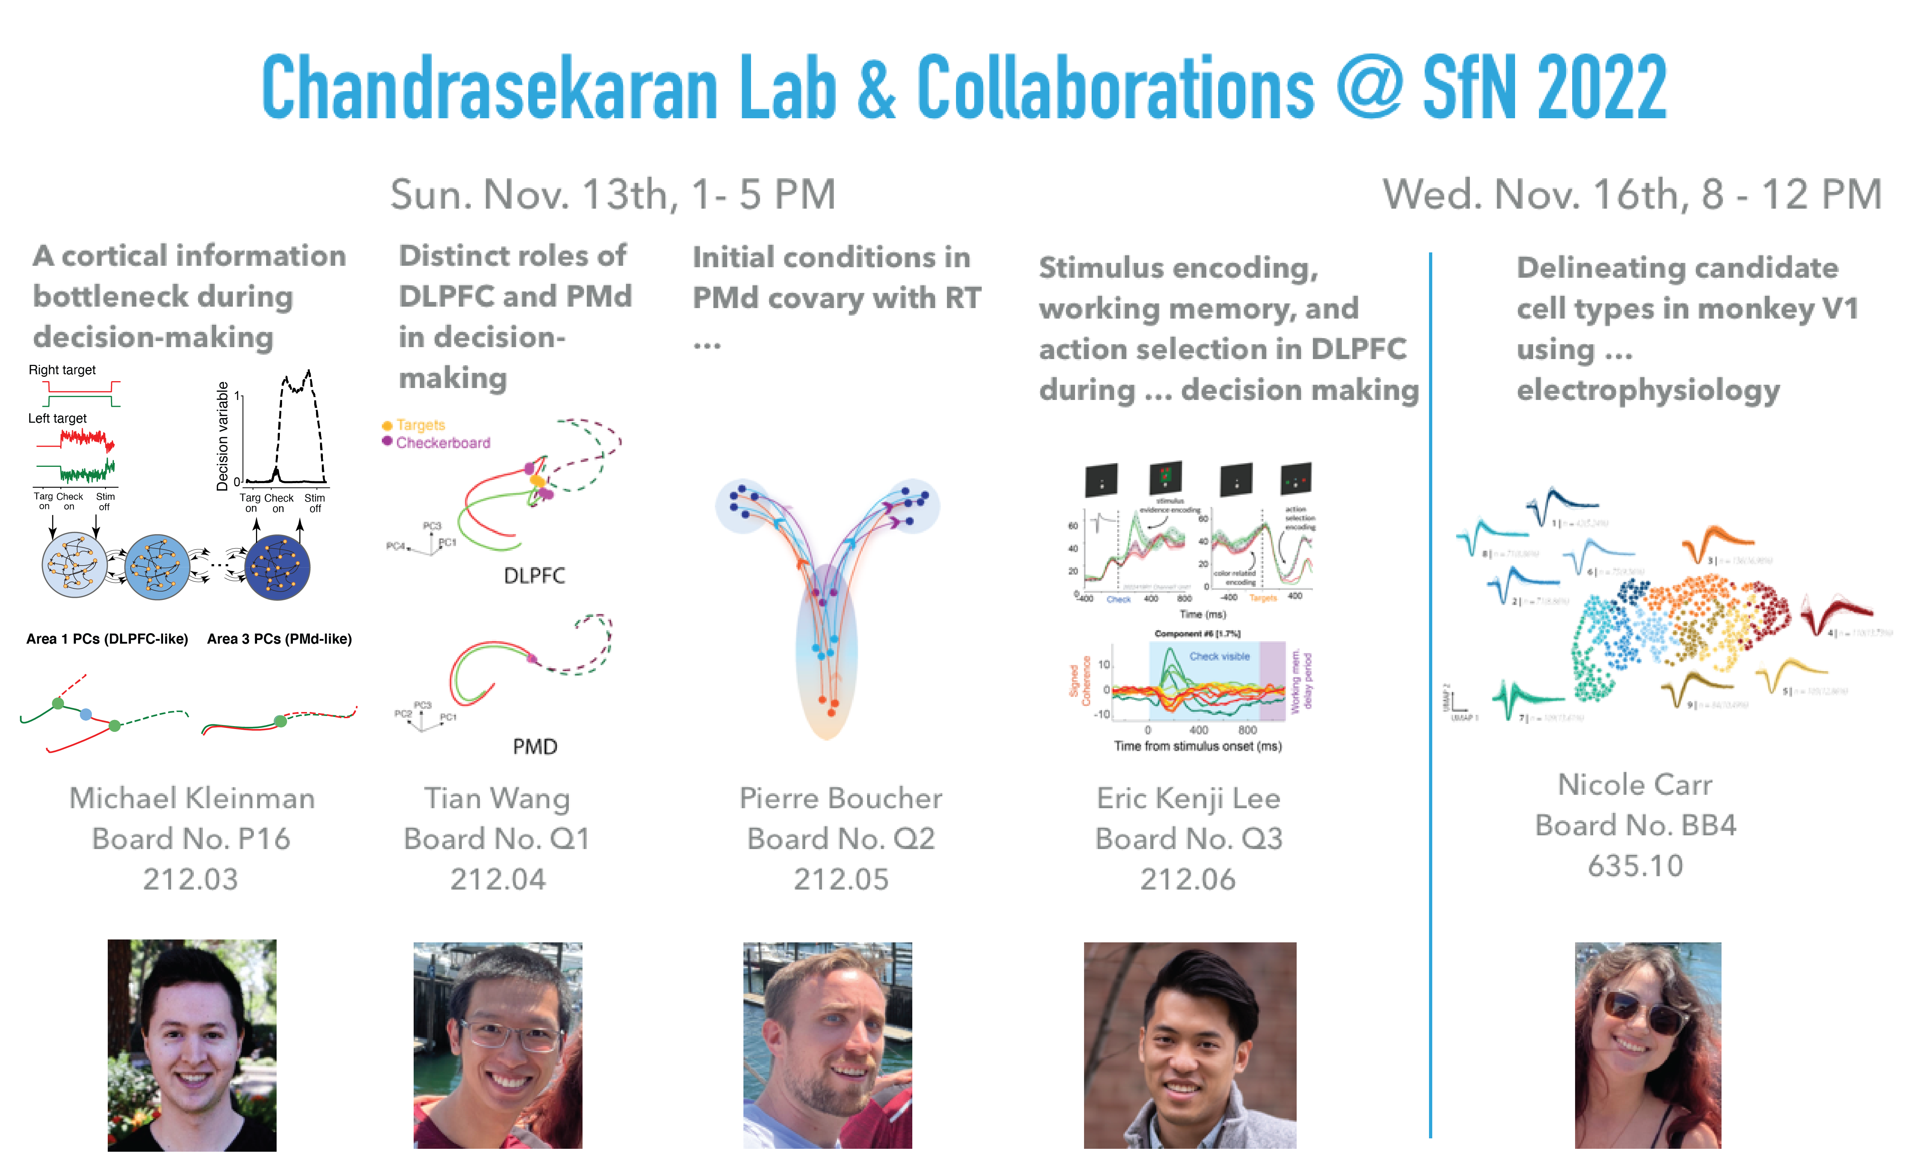
Shameless lab and collaboration promotion
Sun. Nov. 13th, 1- 5 PM
Wed. Nov. 16th, 8 - 12 AM

Slide 16
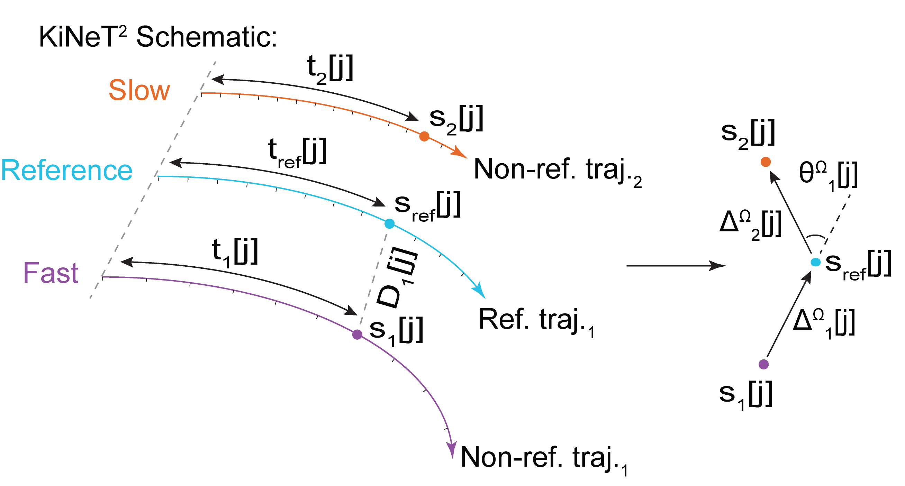
KiNeT

Slide 17
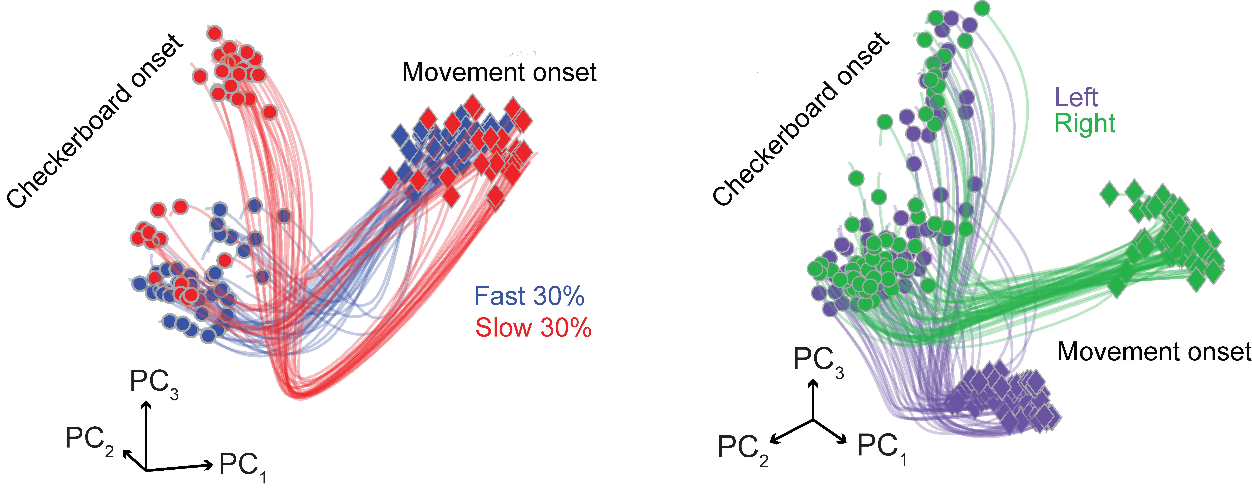
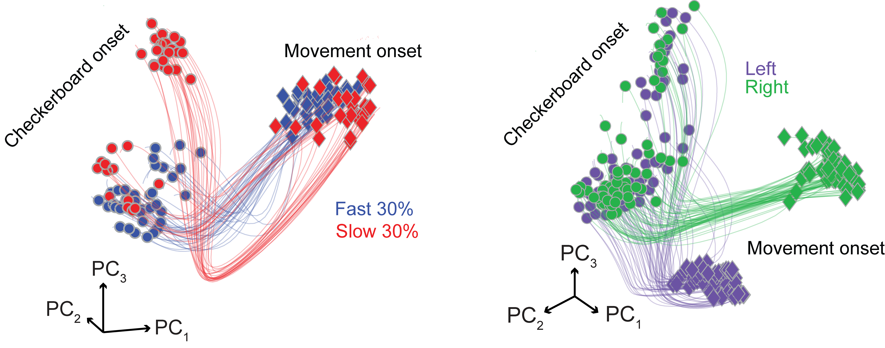
Initial conditions predict RT but do not predict eventual choice

Slide 18
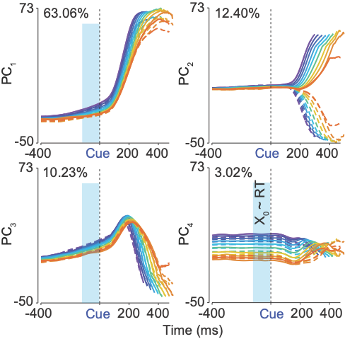
Prestimulus firing rates covary with RT

Slide 19
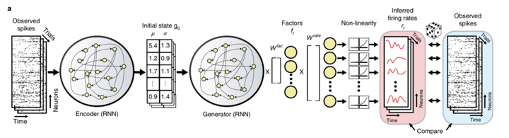
LFADS overview

Slide 20
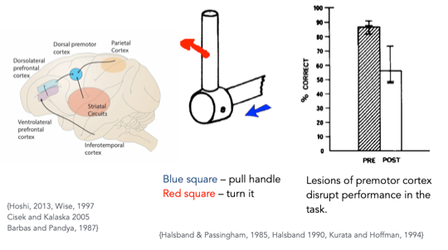
PMD is involved in motor actions based on sensory cues

